Slide 1
Exploring Street Greenery Distribution to Understand Socio-Economic Situation in Residential and Commercial Areas: A Machine Learning Approach Using Street View and Satellite Imagery.
PRESENTED BY GROUP NO: 4411
ID: 190204024 Sudeepta Chandra Paul
ID: 190204106 Janak Mallik
ID: 190204092 MD. Habibun Nabi
ID: 190104040 Hasibul Haque
SUPERVISED BY
Mr. Shoeb Mohammad Shahriar,
Assistant Professor
Department of CSE, AUST

Slide 2
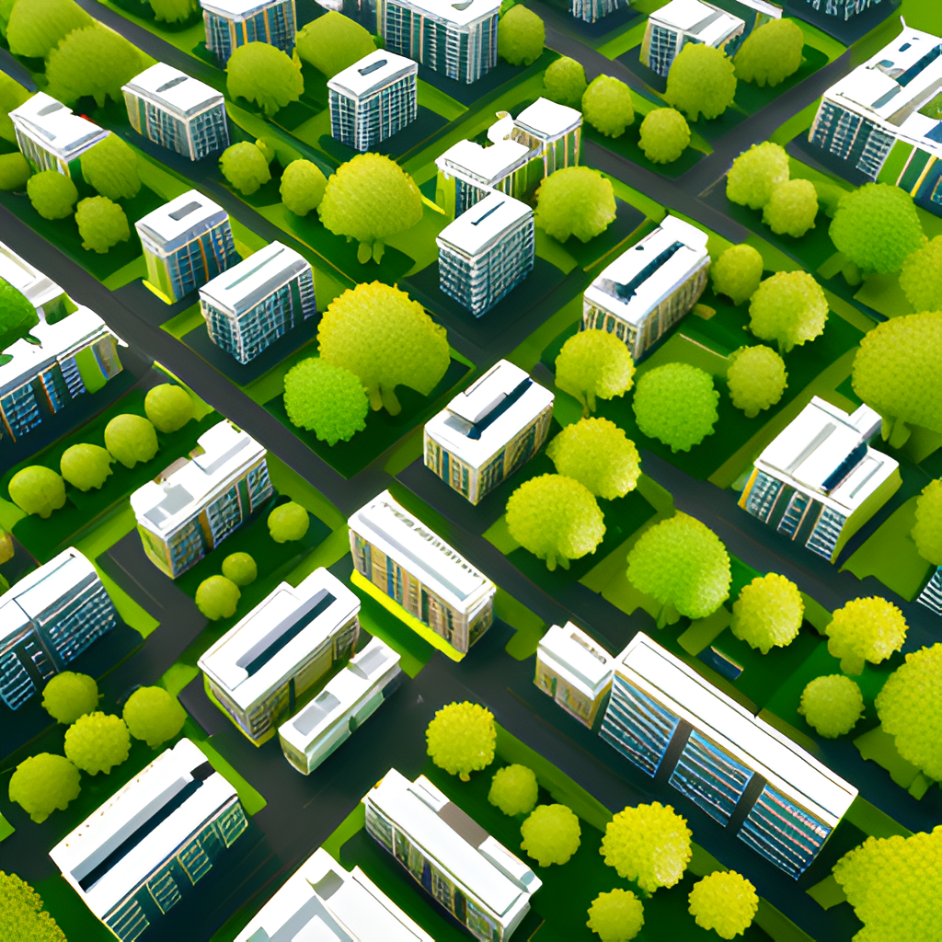
INTRODUCTION
1.Urban green spaces provide multiple benefits, but absence or unequal access in their distribution raise concerns.
2.This research investigates the correlation between the socio-economic situation and street greenery distribution.
3.Street greenery contributes to neighborhood attractiveness, walkability, creating a peaceful environment and resident well-being.
4.Greenery helps reduce the urban heat island effect, reduce power consumption contributing to a more sustainable urban environment.
5.The goal is to promote greenery and it's equitable access to urban green spaces.

Slide 3
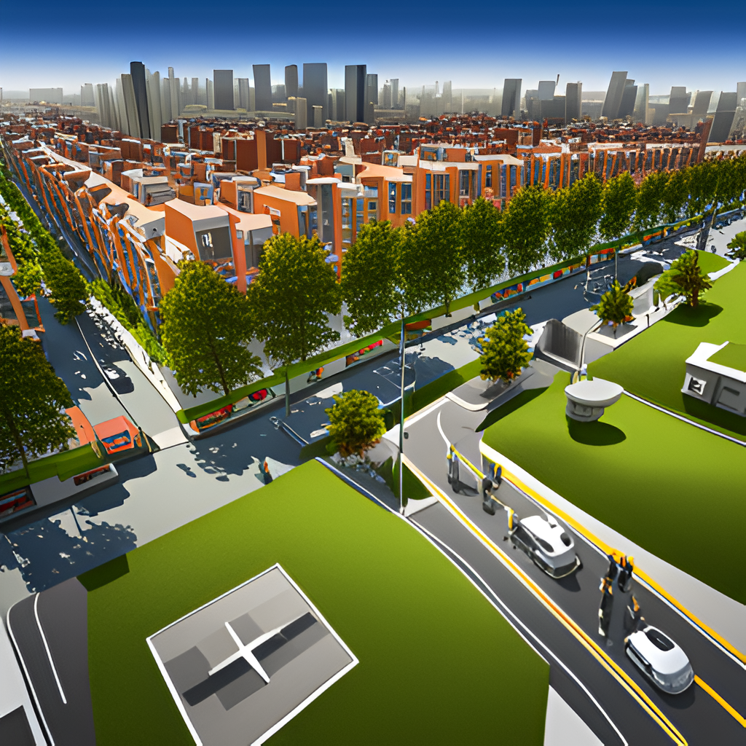
MOTIVATION
1.The motivation behind this thesis stems from the importance of urban green spaces in enhancing the quality of life and well-being of urban residents.
2.How greenery is distributed in residential areas, and is it sufficient enough for a stable socio-economic conditions.
3.Comparing the distribution of greenery with parameters such as property values, thermal comfort, energy consumption, and respiratory diseases.
4.Informing urban planning and policy-making for quality access to green spaces and addressing environmental disparities.

Slide 4
LITERATURE REVIEW
1. “Who lives in greener neighborhoods? The distribution of street greenery and its association with residents’ socioeconomic conditions in Hartford, Connecticut, USA.” [1]
DATASET: the dataset used in the thesis consists of google street view (GSV) images and census data, seven social variables at the block group level were chosen from the 2008-2012, american community survey (ACS) data.
Methodology:
- Collection of google street view (GSV) images.
- Green view index calculation and mapping.
- Extraction of social variables from census data.
Result: the green view index values varied from 2.6 to 61.8, with a mean value of 24.4 .

Slide 5
LITERATURE REVIEW
2. “The distribution of greenspace quantity and quality and their association with neighborhood socioeconomic conditions in Guangzhou, China: A new approach using deep learning method and street view images.” [2]
Methodology:
1.Machine-learning based image segmentation
2.Fully convolutional neural network
Dataset: Attributes of the dataset include street view images of guangzhou, china.(ADE20K dataset)
Result: The accuracy of the fcn-8s was with 0.814 for the training data and 0.811 for the test data in this study.

Slide 6
LITERATURE REVIEW
3. “Measuring daily accessed street greenery: A human-scale approach for informing better urban planning practices” [3]
Methodology:
Machine-learning based extraction and classification of green view index, measuring street accessibility and integration with visible street greenery
Dataset:
The researchers used a dataset called placepulse 2.0, which contained 1.1 million images.
Result:
The results showed an average accuracy of 70.53%.

Slide 7
LITERATURE REVIEW
4. “Deep Green Diagnostics: Urban Green Space Analysis Using Deep Learning and Drone Images” [4]
Methodology:
A convolutional neural network (CNN) for extracting features from the images and a multilayer perceptron (MLP) acting as a classifier.
Dataset:
The data for the study was collected using a DJI phantom 4 drone, which captured 9901 aerial images from parks, university campuses, suburban neighbourhoods, and forested areas.
Result:
The study results showed that the test accuracy, precision, and recall was 72%, while the f1-score was 71%.

Slide 8
LITERATURE REVIEW
5. “Development of a system for assessing the quality of urban street-level greenery using street view images and deep learning” [5]
Methodology:
Panoramic view green view index (PVGVI), deep convolutional neural network (CNN) using deeplabv3+.
Dataset:
The research utilized the cityscapes dataset, comprising recorded street videos from 50 cities, to evaluate their proposed method. For the study area in suita, osaka, japan, a total of 24,920 google street view images (1000 × 1000 pixels) were utilized.
Result:
The research results showed that the proposed method achieved an miou of 78.37%, an RMSE of 2.75%, and an MAE of 2.28%.

Slide 9
1.Limited understanding of street greenery distribution in relation to socioeconomic factors.
2.Insufficient Integration of Machine Learning, advanced machine learning approach needed.
RESEARCH GAP

Slide 10
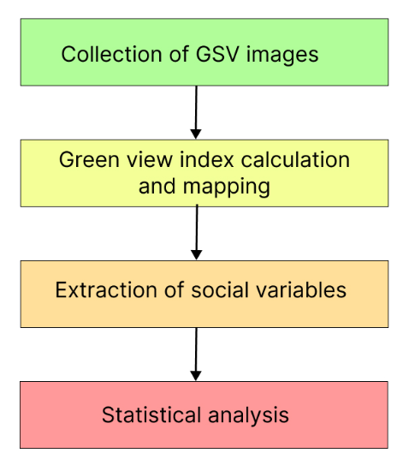
PROPOSED METHODOLOGY
Collection of Satellite and Google Street View (GSV) Images:
- road map collection
- Sample sites will be generated using ArcGIS.
- Satellite and GSV images collection
Green View Index Calculation and Mapping:
- Object-based image analysis
- The images will be segmented using the mean-shift algorithm.
- Spectral analysis and rules to differentiate green areas from non-green areas.
- The green view index calculation
Extraction of social variables:
- Social variable collection
Statistical Analyses:
Ordinary least square (OLS) multivariate regression will be conducted to model the relationships between the green view index and the independent variables.

Slide 11

CONCLUSION
Our research focused on exploring street greenery distribution and its correlation with the socio-economic situation in residential and commercial areas.
By utilizing a machine learning approach and analyzing street view and satellite imagery, we want to gather comprehensive data on street greenery coverage and its spatial distribution.
Our desire is to enhances understanding the distribution of street greenery and it’s influences on socio-economic factors driving sustainable and inclusive urban planning. Overall, our aim is to foster vibrant, healthy, and equitable communities through our research and its impact on urban planning and development.

Slide 12
REFERENCES
[1] Rustamov, J.; Rustamov, Z.; Zaki, N. Green Space Quality Analysis Using Machine Learning Approaches. Sustainability 2023, 15, 7782.
[2] Wang, R.; Feng, Z.; Pearce, J.; Yao, Y.; Li, X.; Liu, Y. The distribution of greenspace quantity and quality and their association with neighbourhood socioeconomic conditions in Guangzhou, China: A new approach using deep learning method and street view images. Sustain. Cities Soc. 2021, 66, 102664.
[3] Ye, Y.; Richards, D.; Lu, Y.; Song, X.; Zhuang, Y.; Zeng, W.; Zhong, T. Measuring daily accessed street greenery: A human-scale approach for informing better urban planning practices. Landsc. Urban Plan. 2019, 191, 103434.
[4] Moreno-Armendáriz, M.A.; Calvo, H.; Duchanoy, C.A.; López-Juárez, A.P.; Vargas-Monroy, I.A.; Suarez-Castañon, M.S. Deep Green Diagnostics: Urban Green Space Analysis Using Deep Learning and Drone Images. Sensors 2019, 19, 5287.
[5] Xia, Y.; Yabuki, N.; Fukuda, T. Development of a system for assessing the quality of urban street-level greenery using street view images and deep learning. Urban For. Urban Green. 2021, 59, 126995.

Slide 13
Thank You!
We are open to any relatable queries.

